Slide 1


Welcome you all
MySQL
Day 4
D.Sakthivel
Assistant Professor & Trainer,
KGiSL Micro College
KGiSL Campus, Coimbatore – 641 035.

Slide 2
Day 4
What is Index?
Creating an Index
Showing an index
Drop an index

Slide 3
What is Index?
An index is a data structure that allows us to add indexes in the existing table.
It enables you to improve the faster retrieval of records on a database table.
It creates an entry for each value of the indexed columns.
We use it to quickly find the record without searching each row in a database table whenever the table is accessed.
We can create an index by using one or more columns of the table for efficient access to the records.

Slide 4
What is Index?
When a table is created with a primary key or unique key, it automatically creates a special index named PRIMARY.
We called this index as a clustered index.
All indexes other than PRIMARY indexes are known as a non-clustered index or secondary index.

Slide 5
MySQL CREATE INDEX Statement
Generally, we create an index at the time of table creation in the database.
The following statement creates a table with an index that contains two columns col2 and col3.
mysql> CREATE TABLE t_index( col1 INT PRIMARY KEY, col2 INT NOT NULL, col3 INT NOT NULL, col4 VARCHAR(20), INDEX (col2,col3) );
If we want to add index in table, we will use the CREATE INDEX statement as follows:
mysql> CREATE INDEX [index_name] ON [table_name] (column names)
In this statement, index_name is the name of the index, table_name is the name of the table to which the index belongs, and the column_names is the list of columns.

Slide 6
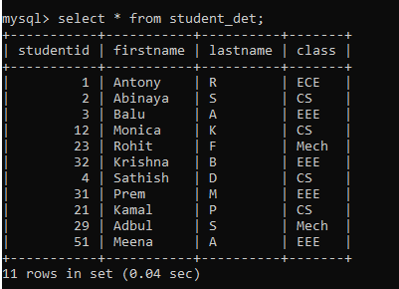
Example:

Slide 7
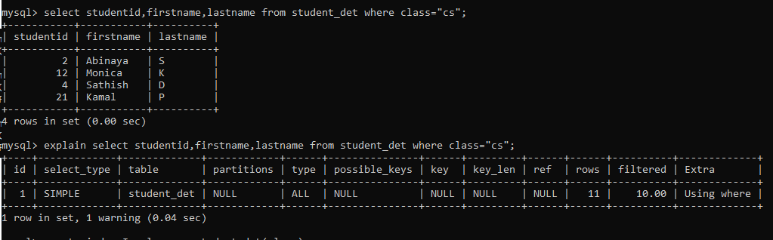
Example:
In above output MySQL scans the whole table that contains 11 rows to find the student whose class is the CS branch.

Slide 8
EXPLAIN keyword:
The EXPLAIN keyword is used to obtain information about how our SQL databases execute the queries in MySQL.
It is synonyms to the DESCRIBE statement.
In practice, the DESCRIBE keyword provides table structure information, whereas the EXPLAIN keyword gives the query execution plan.
It is a powerful tool to understand and optimize the queries in MySQL, but developers used it very rarely.

Slide 9
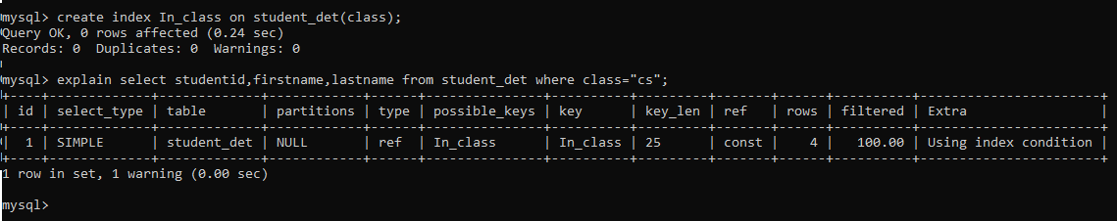
Creating an Index:
After executing the above statement, the index is created successfully. In this output, MySQL finds four rows from the class index without scanning the whole table. Hence, it increases the speed of retrieval of records on a database table.

Slide 10
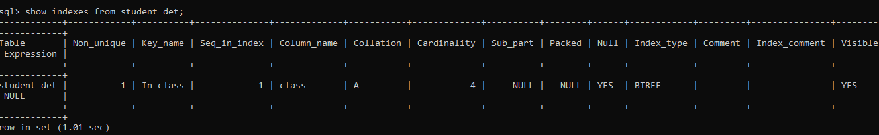
Show an Index
Syntax:
Show indexes from tablename;

Slide 11
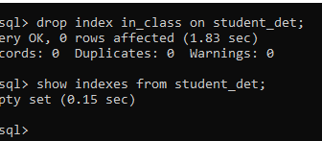
Drop an Index
Syntax:
Drop index indexname on tablename;

Slide 12



Thank You

